Slide 2
$ mkdir test
$ cd test
$ git init
Initialized empty Git repository in C:/Users/linchao/test/.git/
linchao@DevH10 MINGW64 ~/test (master)
$ touch a.txt
$ git add .
$ git commit -m "add a.txt"
[master (root-commit) 9ffce05] add a.txt
1 file changed, 0 insertions(+), 0 deletions(-)
create mode 100644 a.txt
$ git branch
* master
$ git branch b1
linchao@DevH10 MINGW64 ~/test (master)
$ git branch
b1
* master
linchao@DevH10 MINGW64 ~/test (master)
$ git checkout b1
Switched to branch 'b1'
linchao@DevH10 MINGW64 ~/test (b1)
$ git branch
* b1
master
$ touch b.txt
$ add .
$ git commit -m "add b.txt"
[b1 99a75d5] add b.txt
1 file changed, 0 insertions(+), 0 deletions(-)
create mode 100644 b.txt
linchao@DevH10 MINGW64 ~/test (b1)
$ git branch
* b1
master
$ git checkout -b branch3
Switched to a new branch 'branch3'
linchao@DevH10 MINGW64 ~/test (branch3)
$ touch c.txt
$ git add .
$ git commit -m "add c.txt"
[branch3 dae324c] add c.txt
1 file changed, 0 insertions(+), 0 deletions(-)
create mode 100644 c.txt
linchao@DevH10 MINGW64 ~/test (branch3)
$ git checkout master
Switched to branch 'master'
linchao@DevH10 MINGW64 ~/test (master)
$ git branch
b1
branch3
* master
$ git checkout -b b4
Switched to a new branch 'b4'
linchao@DevH10 MINGW64 ~/test (b4)
$ touch d.txt
$ git add .
$ git commit -m "add d.txt"
[b4 8bfa733] add d.txt
1 file changed, 0 insertions(+), 0 deletions(-)
create mode 100644 d.txt
linchao@DevH10 MINGW64 ~/test (b4)

Slide 3
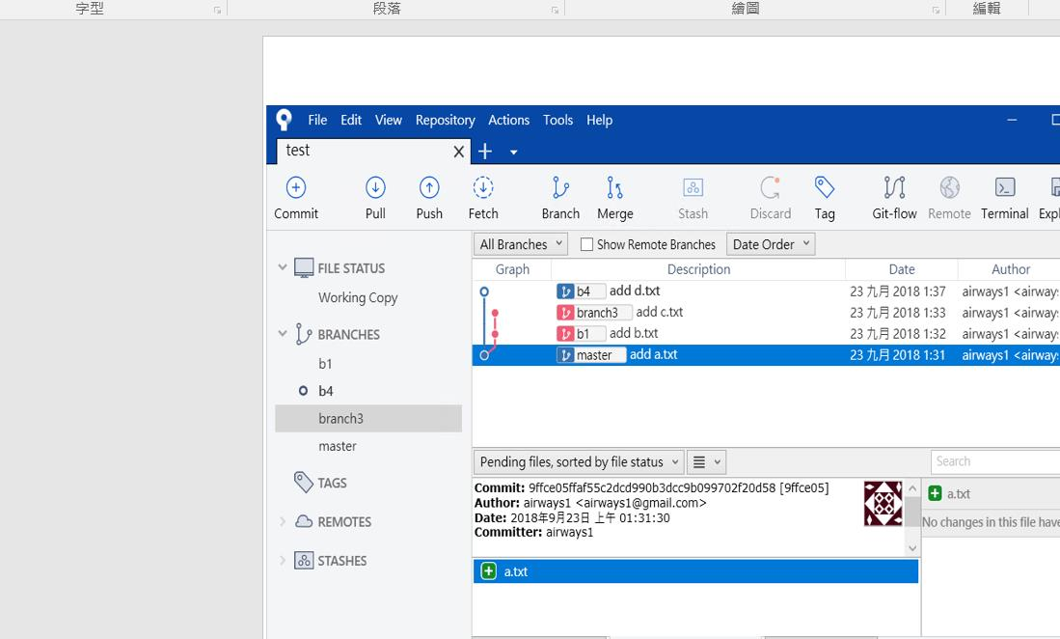

Slide 4
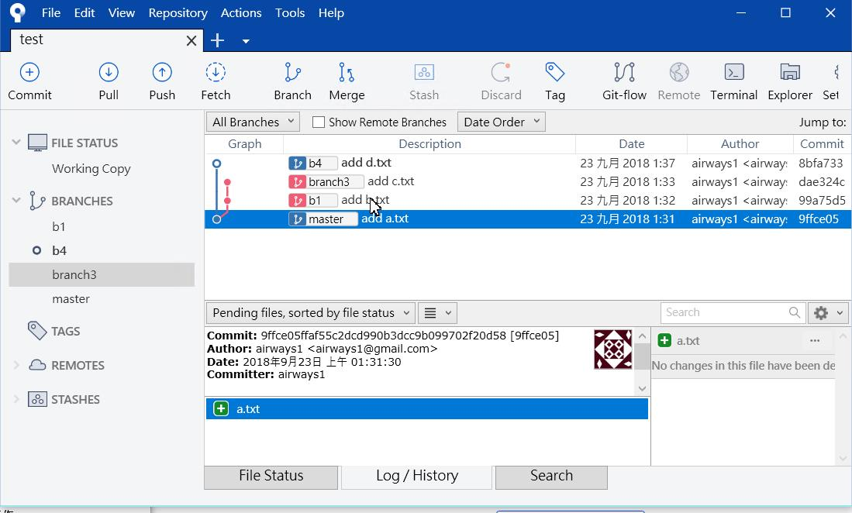

Slide 5
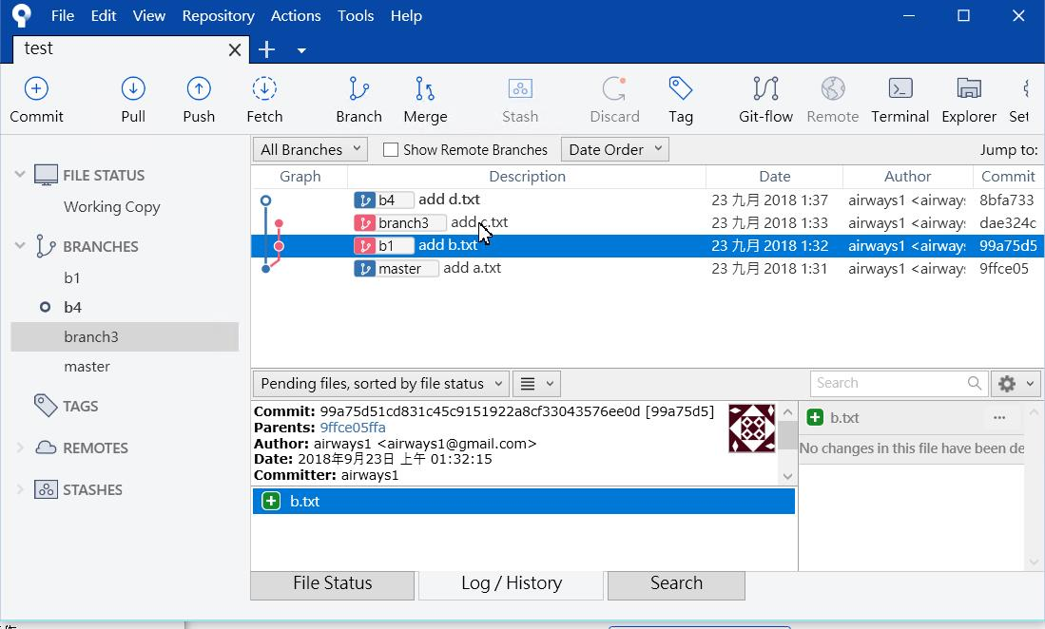

Slide 6
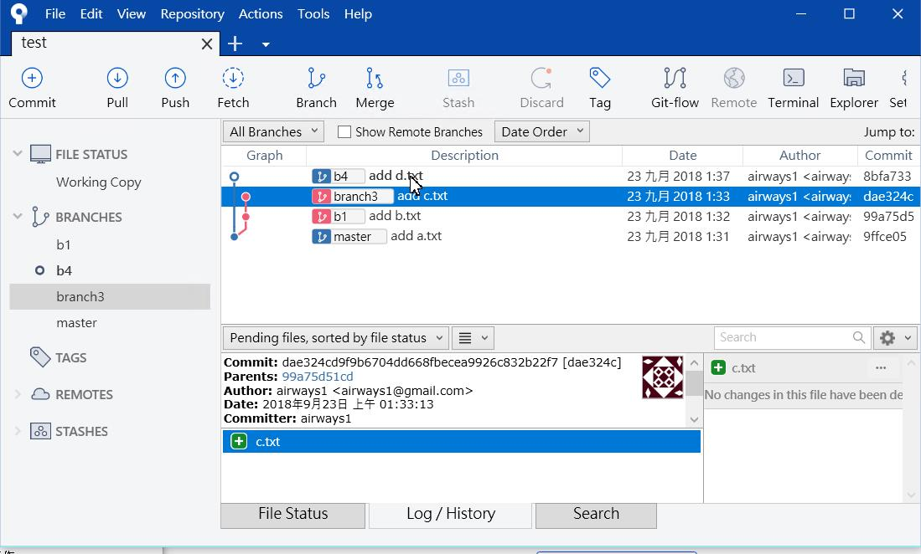

Slide 7
